Slide 1


Innovative Software Solution for Malaria Eradication
This presentation explores an advanced software tool aimed at eradicating malaria in Africa. It highlights the software's technological features, such as data analytics and predictive modeling, while assessing its impact on healthcare systems and its potential to enhance disease management strategies. By leveraging modern technology, this software intends to significantly reduce malaria incidence and improve public health outcomes.

Slide 2




Introduction to Malaria
241 million
95%
Children and Pregnant Women
Global Cases
African Cases
Vulnerable Populations
In 2021, there were an estimated 241 million cases of malaria worldwide.
Africa accounted for 95% of these cases, highlighting the urgent need for effective interventions.
Malaria disproportionately affects vulnerable populations, particularly children and pregnant women.

Slide 3




Software Features
This software provides essential features for tackling malaria transmission through advanced analytics, predictive modeling, and a user-friendly interface for healthcare professionals.
Predictive Modeling
Employs machine learning algorithms to predict outbreaks based on environmental and historical data.
2
Data Analytics
The software utilizes advanced data analytics to monitor malaria transmission patterns and identify high-risk areas.
1
User-Friendly Interface
Features an intuitive interface designed for healthcare professionals for easy data entry and reporting.
3

Slide 4


Implementation Strategies
1
Collaboration with Local Health Authorities
2
Training Programs
3
Community Engagement
Comprehensive training will be provided to healthcare workers on using the software effectively, focusing on data interpretation and decision-making based on insights generated.
Engaging local communities through awareness campaigns will foster cooperation and encourage participation in malaria prevention and control efforts.
The software will be implemented in partnership with local health agencies to ensure it meets specific regional needs and integrates into existing healthcare systems.

Slide 5

Expected Outcomes
Improved Disease Management
Reduced Malaria Incidence
Enhanced Reporting and Accountability
The software is expected to enhance the management of malaria cases, leading to quicker response times and more effective treatment protocols.
By identifying and targeting high-risk areas, the software aims to significantly reduce malaria transmission rates and improve overall public health outcomes.
The software will streamline data reporting processes, improving transparency and accountability in malaria control initiatives.

Slide 6

Case Studies
Success Stories
Testimonials from healthcare workers using the software highlight its positive impact on their ability to track and respond to malaria cases, improving patient outcomes.
Pilot Programs
2
Initial pilot programs in select African regions have demonstrated the software's effectiveness in reducing malaria cases by up to 30% within the first year of implementation.
1
Lessons Learned
Key takeaways from pilot programs include the importance of community involvement and the need for continuous adaptation of the software to meet evolving challenges.
3

Slide 7

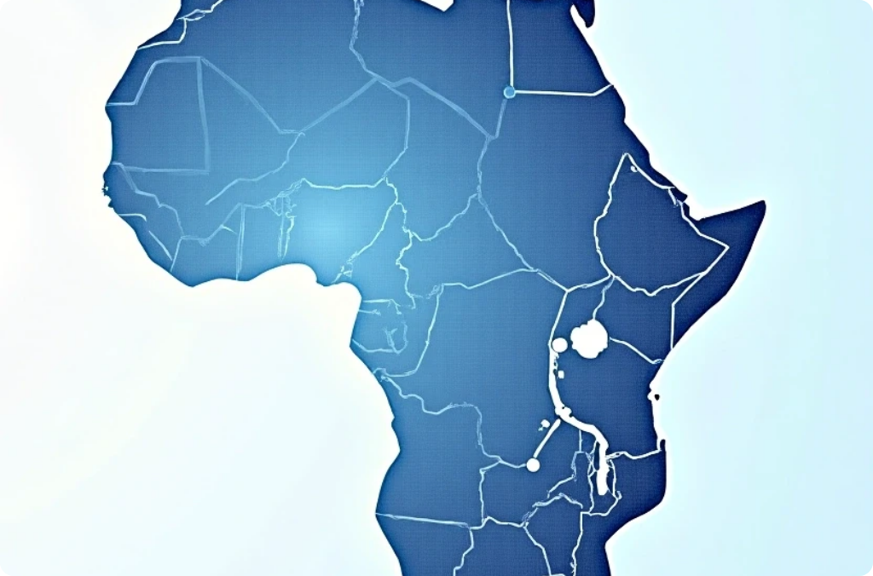


Future Directions
Scalability Plans
Integration with Other Health Systems
Continuous Improvement
Future initiatives aim to scale the software across multiple African countries, tailoring features to local needs and enhancing its adaptability to various healthcare settings.
Efforts will be made to integrate the software with existing health information systems, allowing for a more comprehensive approach to disease management.
Ongoing updates and improvements will be based on user feedback and advances in technology, ensuring the software remains effective and relevant in the fight against malaria.

Slide 8


Conclusion on the Fight Against Malaria
Call to Action
Vision for the Future
The fight against malaria requires innovative solutions like this software. Collaboration among governments, healthcare providers, and communities is essential to maximize impact and achieve eradication goals.
With continued investment in technology and healthcare infrastructure, there is potential for a malaria-free Africa, improving the quality of life and economic stability for millions.

